Slide 1
EES203: Geochemistry
Instructor: Anoop Ambili
Email id: anoop@iisermohali.ac.in

Slide 2
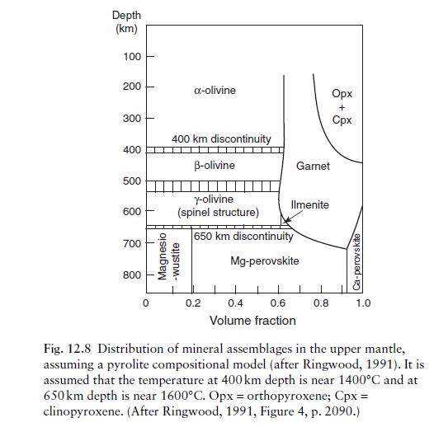
Spinel: magnesium aluminate (MgAl₂O₄),

Slide 3
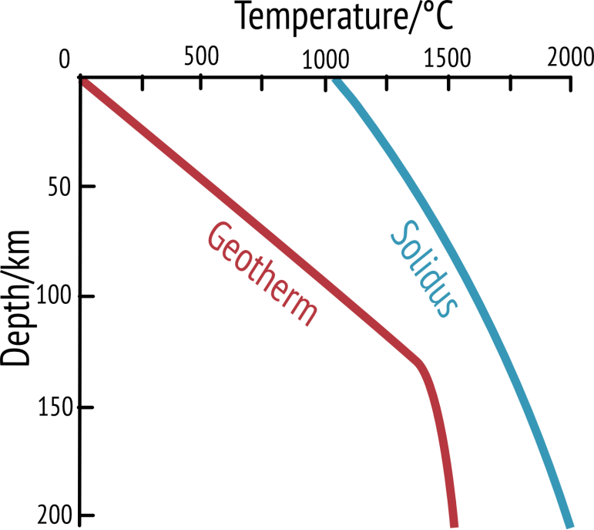
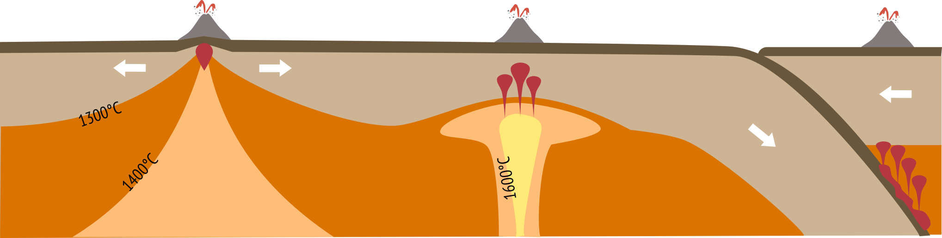
Magma generation
Average section of crust and mantle (i.e. away from plate boundaries)
No magma generated
Notes:
The red line on the graph is the geothermal gradient which shows the rate of increasing temperature with respect to increase with depth into the Earth’s interior. On average (i.e. away from plate boundaries) temperature increases at a rate of 25-30°C per km in the lithosphere. The kink in the geothermal gradient indicates the lithosphere-asthenosphere boundary which occurs at 1300°C.
For rocks to melt the geothermal gradient (or geotherm) must cross the solidus (blue line). The solidus marks the transition from solid mantle rock to rock that can melt and form pockets of magma. Because of pressure increases the solidus increases in temperature the further down you go. In an average section of crust and mantle the geotherm does not cross the solidus and therefore no liquid magma can be produced (the solidus is for the rock peridotite which makes up the average composition of the mantle).
There are three situations where we can get the geotherm to cross the solidus and therefore we can get melting and so we can get magma for our volcanoes.

Slide 4
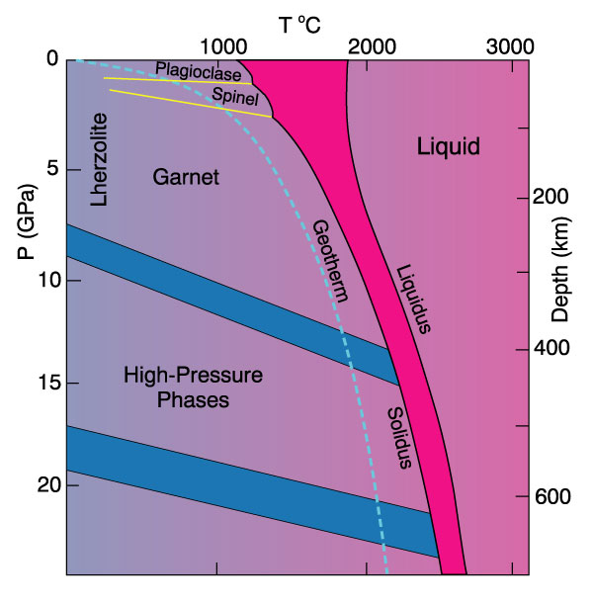

Slide 5

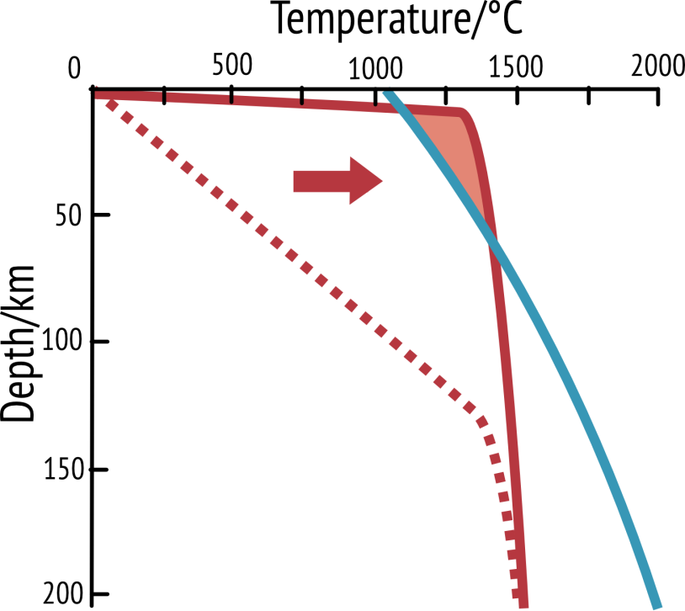
1. Mid ocean ridge
Magma generated
Notes:
This graph shows what happens at a constructive/divergent boundary – a point where two plates are moving away from each other (for example in the Mid Atlantic ridge). Because the lithosphere is thinned here, the asthenosphere (which is hotter) rises and therefore the geotherm is much shallower and crosses the solidus near the top of the graph. Therefore in this zone magma can be generated and we can get volcanoes and new basaltic ocean crust.

Slide 6
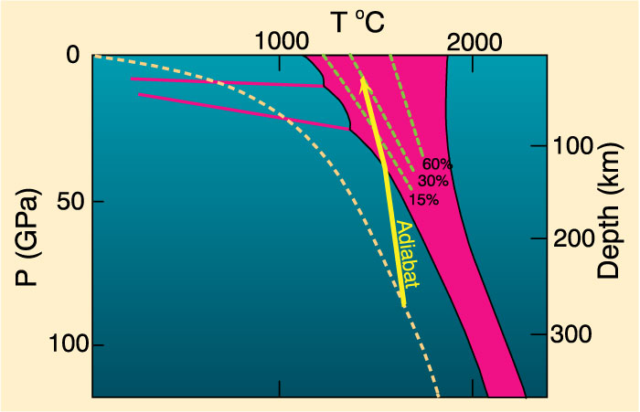
Decompression melting could melt at least 30%
Figure 10-4. Melting by pressure reduction. Melting begins when the adiabat crosses the solidus and traverses the shaded melting interval. Dashed lines represent approximate % melting.
Notes:
Adiabatic rise of mantle with no conductive heat loss
Steeper than solidus
Intersects solidus
Δ slope = heat of fusion as mantle melts
Decompression melting could melt at least 30%

Slide 7

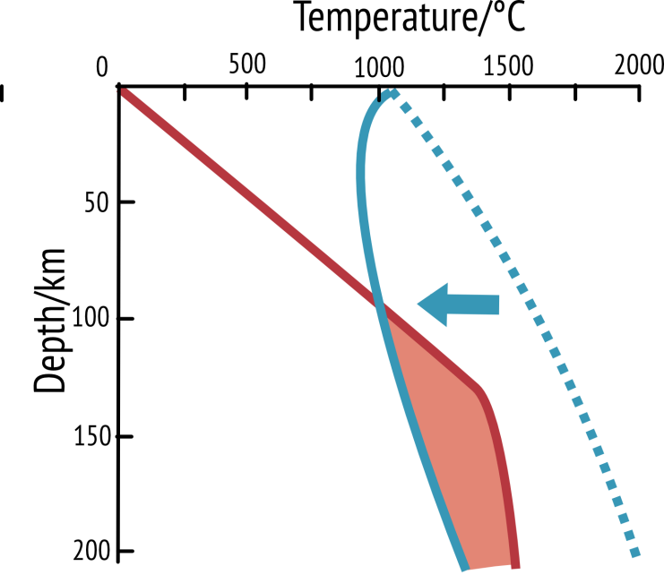
3. Subduction zone
Magma generated
Notes:
This graph shows what happens when water gets into the mantle – this is what happens at subduction zones (destructive/convergent boundaries) where one tectonic plate is thrust beneath another. Hydrated minerals in the crust heat up and release water into the mantle lowers the mantles melting point and therefore the shape of the solidus changes – hydrated mantle rocks melt at a lower temperature and whilst the geotherm has stayed the same, it now crosses over the solidus and can generate magma.

Slide 8
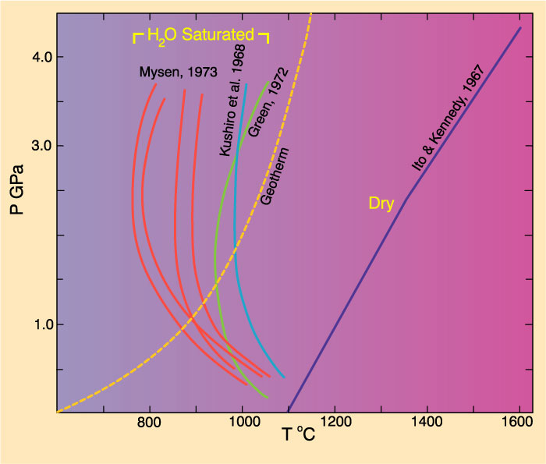
Add volatiles (especially H₂O)
Figure 10-4. Dry peridotite solidus compared to several experiments on H2O-saturated peridotites.

Slide 9
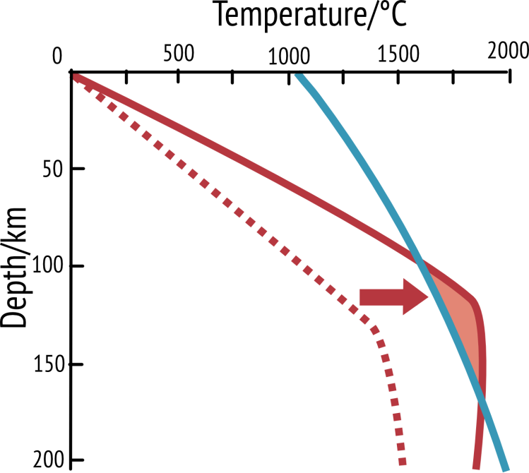
Magma generated
2. Hotspot
Notes:
This graph shows what happens when we increase the temperature of the mantle. This happens when there is a hotspot in the mantle for example under the Hawaiian Islands. Because the mantle temperature is hotter than usual, the geotherm shifts to the right and crosses the mantle solidus. Therefore we can generate molten magma.

Slide 10
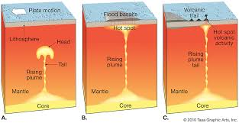
Hotspots

Slide 11
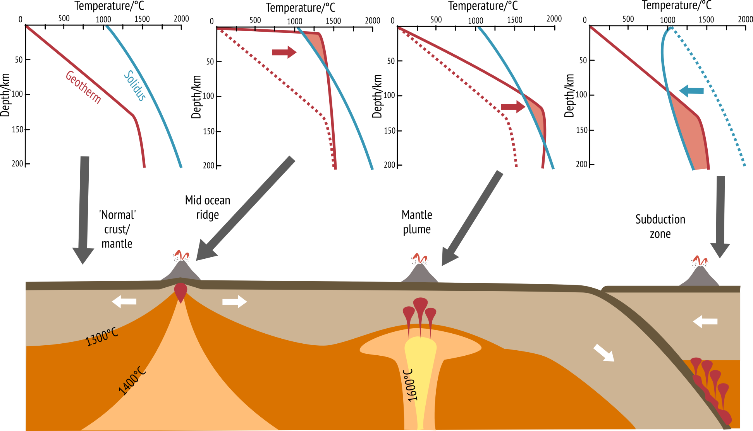
Magma generation from the mantle
a)
b)
c)
d)

Slide 12
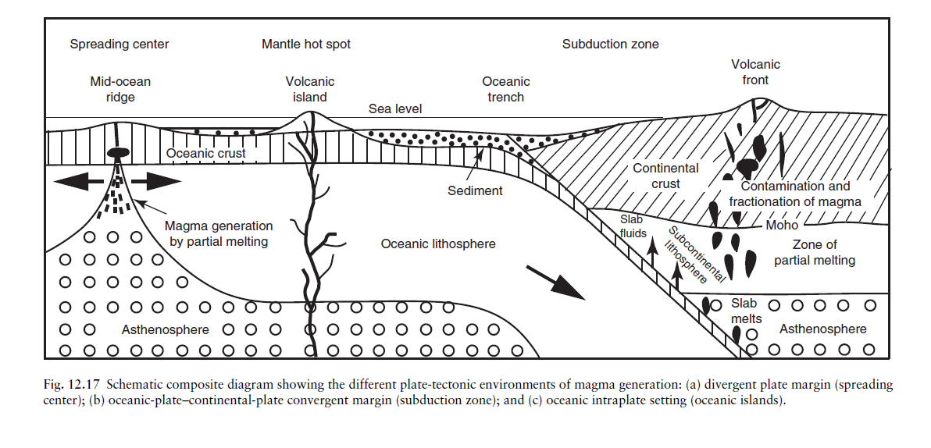

Slide 13
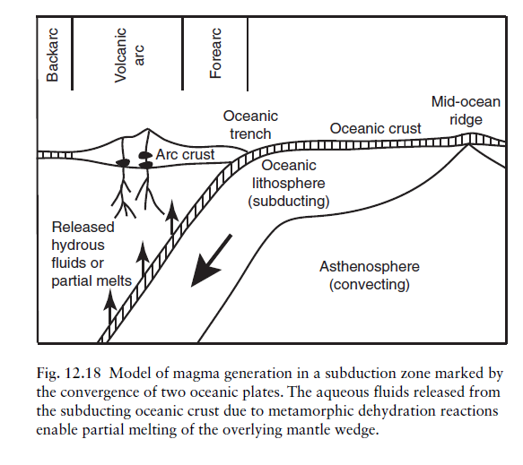

Slide 14
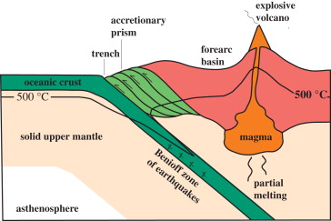

Slide 15
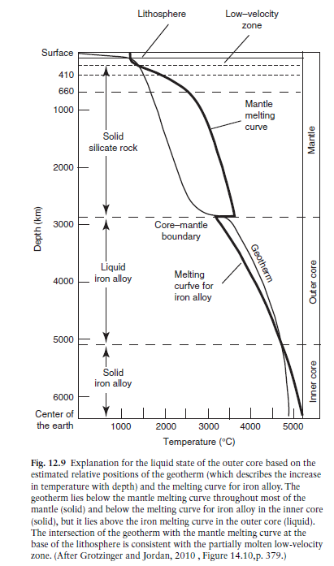
The Earth’s core comprises about 16% of the Earth’s volume and 31% of the Earth’s mass.
Composition for the core (in wt%): Fe – 85.55, O – 5.18, Ni – 4.88, S – 2.69, Cr – 0.45, Mn – 0.41, P – 0.35, Co – 0.22, Cl – 0.07, and possibly K – 0.02

Slide 16
What is the role of partial melting in the diversity of igneous rocks?
Why do igneous rocks vary in composition even if they originate from the same magma source?
3. Can we explain the order of mineral crystallization in magma?
4. What processes lead to the formation of felsic, intermediate, mafic, and ultramafic rocks?
5. How do volatile components (e.g., water, carbon dioxide) influence magma evolution?
6. How do trace elements behave in these systems?

Slide 17
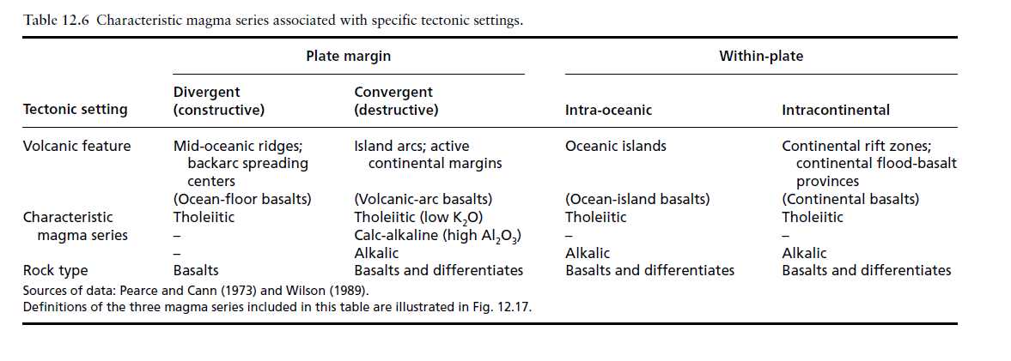
Rocks formed from the solidification Magma?

Slide 18
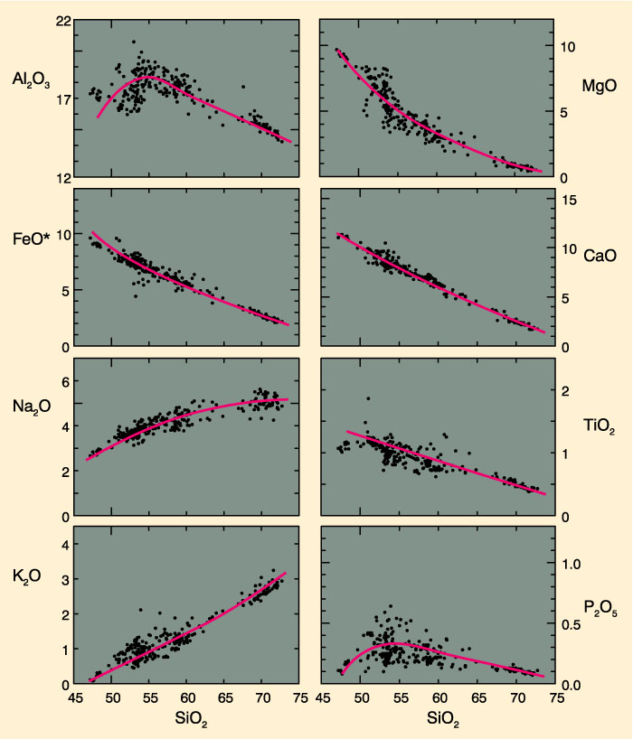
Variation in elemental concentration
Note magnitude of major element changes
Figure 8-2. Harker variation diagram for 310 analyzed volcanic rocks from Crater Lake (Mt. Mazama), Oregon Cascades. Data compiled by Rick Conrey (personal communication). From Winter (2001) An Introduction to Igneous and Metamorphic Petrology. Prentice Hall.

Slide 19
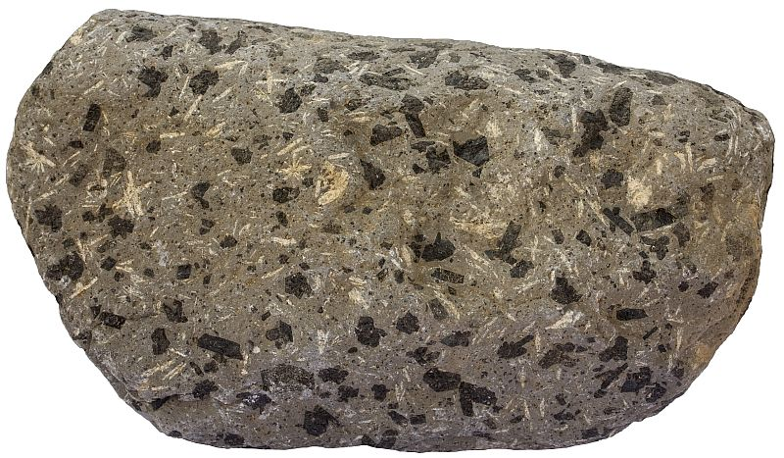
Classification of Igneous Rocks
Textures:
Aphanitic- crystals too small to see by eye
Phaneritic- can see the constituent minerals
Fine grained- < 1 mm diameter
Medium grained- 1-5 mm diameter
Coarse grained- 5-50 mm diameter
Very coarse grained- > 50 mm diameter
Porphyritic- bimodal grain size distribution
Glassy- no crystals formed

Slide 20
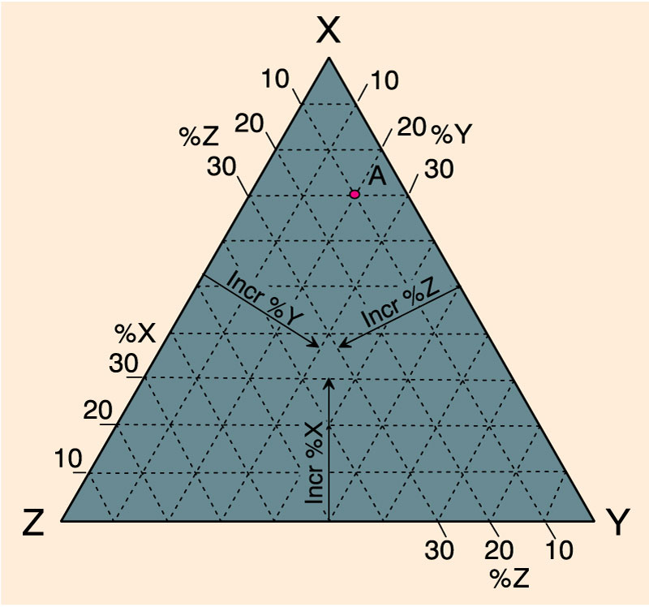
Classification of Igneous Rocks
Figure a. Method for plotting a point with the components: 70% X, 20% Y, and 10% Z on triangular diagrams. An Introduction to Igneous and Metamorphic Petrology, John Winter, Prentice Hall.

Slide 21
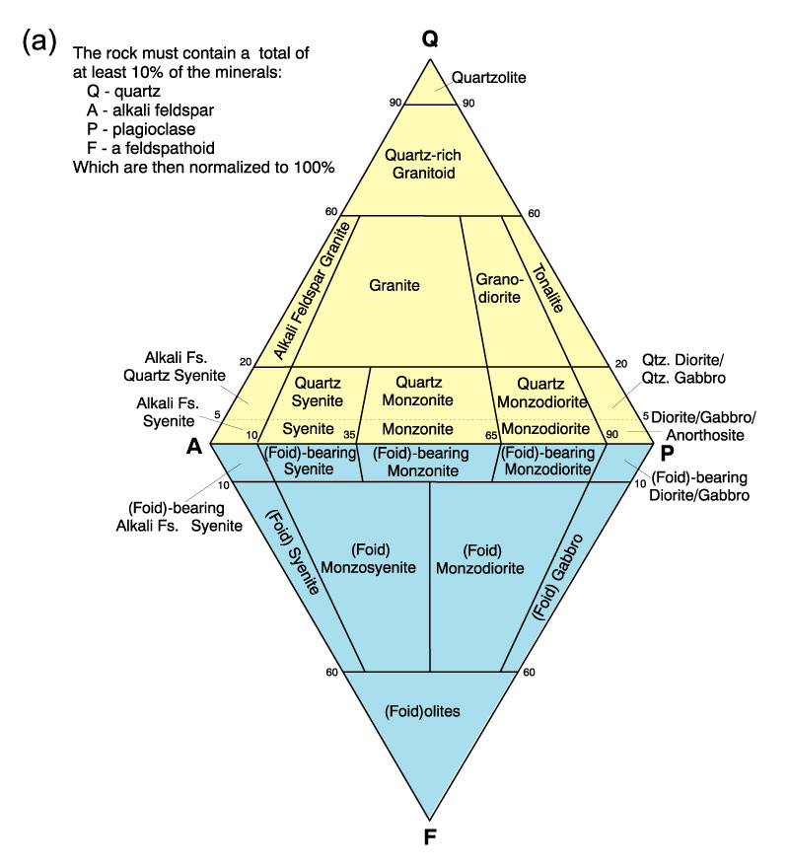
Classification of Igneous Rocks
Figure 2.2a. A classification of the phaneritic igneous rocks: Phaneritic rocks with more than 10% (quartz + feldspar + feldspathoids). After IUGS.

Slide 22
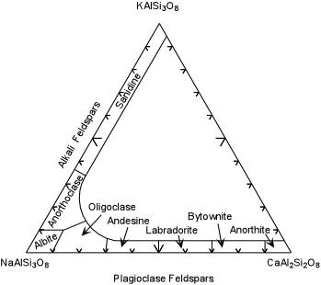
Feldspars have names for very specific ranges of composition. Most cannot be identified in hand specimens.

Slide 23
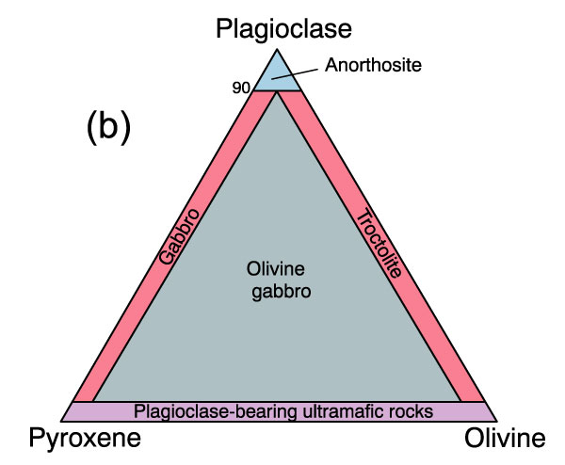
Classification of Igneous Rocks
Figure 2.2b. A classification of the phaneritic igneous rocks: Gabbroic rocks. After IUGS.

Slide 24
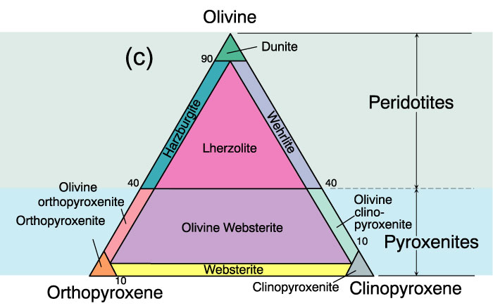
Classification of Igneous Rocks
Figure 2.2c. A classification of the phaneritic igneous rocks: Ultramafic rocks. After IUGS.

Slide 25
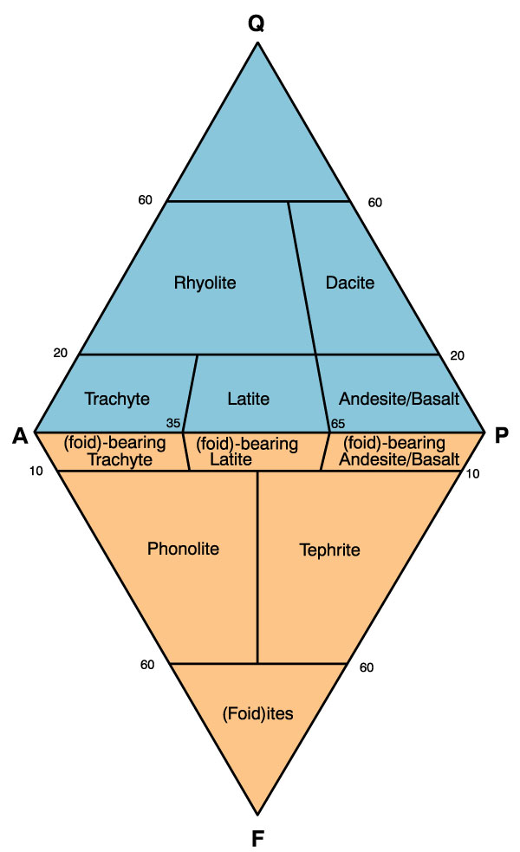
Classification of Igneous Rocks
Figure 2.3. A classification and nomenclature of volcanic rocks. After IUGS.

Slide 26
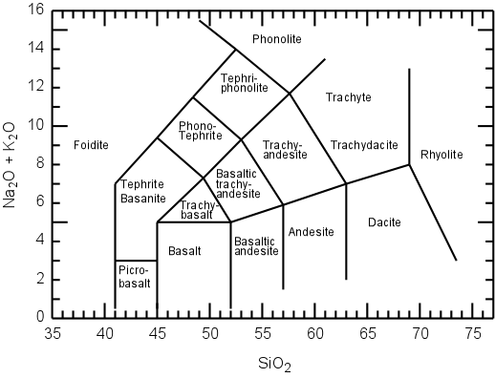
Classification of Igneous Rocks
Figure 2.4. A chemical classification of volcanics based on total alkalis vs. silica. After Le Maitre (2002) . Igneous Rocks: A Classification and Glossary of Terms. Cambridge University Press.

Slide 27
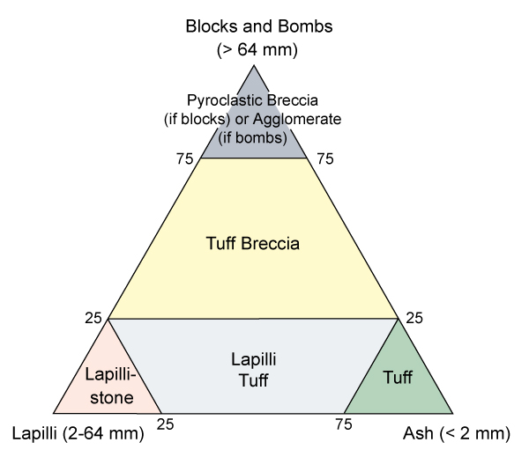
Classification of Igneous Rocks
Figure 2.5. Classification of the pyroclastic rocks. After Fisher (1966) Earth Sci. Rev., 1, 287-298.

Slide 28
